Slide 1
Student Details
NAME :GALIVEETI SAI KUMAR
EMAIL ID :galiveetisaikumar1@gmail.com
Collage name : sri venkateswara college of engineering & technology
Collage state : chittoor
Student id :STU64a7a5485285f1688708424
Internship start and end date : 24 june to 31 july 2024

Slide 2
PROJECT TITLE : Cloning a website for amazon
PROBLEM STATEMENT
→ Create a simplified clone of the Amazon website using HTML,CSS and JavaScipt. The clone should mimic the layout and functionality of Amazon’s hompage, including the header, navigation, search bar, and footer.
→ Include the Amazon logo add a search bar for users to search for products. Create a navigation bar with links to different sections as home, today’s details, customer service, and sell.
→ Display product listings, including images, names, price and ratings. Implement a carousel or slider for featured products or deals of the day include links to various pages such as careers and contact us.
→ Use CSS to style the website to closely resemble Amazon’s layout . Use JavaScript to add basic interactivity functionality search bar that filters product listings based on the search query add a shopping cart with the ability to add and view the total cost

Slide 3
AGENDA
Overview of project objectives and scope. Define key deliverables and milestones
Identify essential features and functionalities to be replicated.
Assess the capabilities of HTML, CSS and JavaScript for replicating the site.
Develop interactive prototypes to visualize user flow.
Integrate HTML, CSS and JavaScript components ensure seamless interaction parts of the website.
Minify and compress CSS and JavaScript files optimize images and implement lazy loading.
Conduct peer reviews to ensure code quality and consistency.
Deliver the final product along with all documentation provide support contact details.

Slide 4
PROJECT OVERVIEW
To create a front end clone of Amazon using HTML, CSS and JavaScript replicating the design, layout and basic functionality of the website.
Replicate the visual design and layout of Amazon, including the homepage, product pages, shopping cart and checkout pages.
Header with logo, search bar banner section with promotional images featured product and categories . Customer reveiews and related products.
Test the website on different devices and screen sizes prepare documentation explaning the code structure and usage instructions.
Add to cart functionality view and remove items from the cart update item quantities form for user information and address order summary and payment options.

Slide 5
WHO ARE THE END USERS of this project?
The end users of the project for cloning the Amazon using HTML, CSS and JavaScript based on their roles and intersets include developers, students, educators and potential customers.
To study and understand how complex e-commerce websites can be bulit using HTML, CSS and JavaScript gain insights into performance optimization and client side functionalities.
To use the front end clone as a base for intergrating and databases to learn and practice front end development skills gain hands on experience by working on a coding and design skills.
To use the project as a teaching tool in web development courses provide students with a practical example of building a complex website of front-end technologies.

Slide 6
YOUR SOLUTION AND ITS VALUE PROPOSITION
The solution involves creating a clone of Amazon using HTML, CSS and JavaScript will replicate the visual design, layout of the Amazon website similar browsing and shopping experience.
Include a header with a logo dynamic sections for best sellers and deals. Form for user information and address order summary and simulated payment options.
Provides a hands on project for developers and students to practice their development skills. Offers practical experience in real word development challenges.
Provides a prototype that small business owners can use as a foundation for developing their own platforms helps identify issues and areas for in a real word context

Slide 7
How did you customize the project and make it your own
Introduced a unique color scheme and custom fonts. Added personalized branding elements like a favicon.
Implemented new functionalities such as a blog section or photo gallery.
Enhanced interactivity with custom Javascript animations and hover effects.
Replaced original content with personalized text, images, and videos.
Minified CSS and Javascript files for faster loading. Implemented lazy loading for images or other media.
Added APIs for dynamic content like social media feeds or weather updates.
Integrated Google Analytics or similar tools to moniter user behaiour and website performances.

Slide 8
MODELLING
HTML
→ set up the basic HTML files including meta tags, links to stylesheet, and scripts.
→ Use semantic HTML elements to create a clear document outline.
CSS
→ Set up global styles, including resets and base styles. Implement the main layout styles grid or flexbox.
→ Use tools like chrome Dev tools to inspect and copy styles from the original website.
JAVASCRIPT
→ Recreate any JavaScript functionallity. This can include interactive elements, or animations.
→ Use breakpoints and console logs to understand JavaScript functionallity.

Slide 9
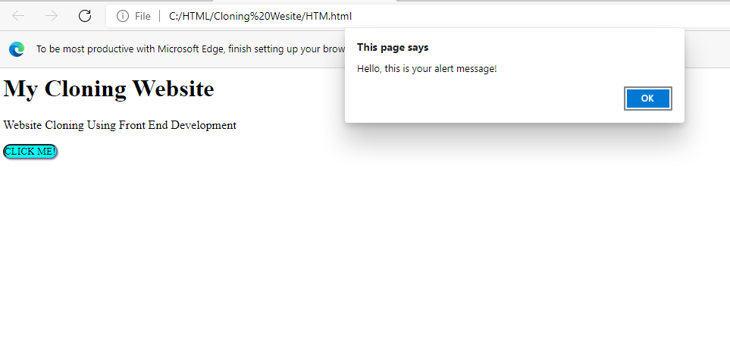
Results

Slide 10
links
https://github.com/Mtharak123/Website-cloning-.git
https://getbootstrap.com
https://cdn.jsdelivr.net/npm/bootstrap@5.3.3/dist/css/bootstrap.min.css
https://cdn.jsdelivr.net/npm/bootstrap@5.3.3/dist/js/bootstrap.bundle.min.js

